Slide 1
Cost calculation of rental cars using
Floyd’s warshall algorithm

Slide 2




Team Presentation
Mohammed Taheer
ENG19CS0186
P Sai Kireeti ENG19CS0215
N Shaik Safi ENG19CS0195
Prarthan P ENG19CS0228

Slide 3
introduction
In our project we use FLOYD’S WARSHALL ALGORITHM to solve the given map.
This algorithm is used to solve the map to find all pair shortest path problem.
In this project we solve bidirectional map.
We are calculating total distance from starting point to ending point and calculating their cost/KM.

Slide 4
objective
The goal of this project is to increase the availability and use of rental cars among travelers and visitors in the state.
We use this project to calculate its cost and minimum distance traveled in a trip.
This project shows route from source to destination using Map
We provide different options to user to select.

Slide 5
Hardware & software requirements
Hardware Requirements:
Processors: Intel® Core™ i3 processor or above version.
Operating systems: 64bit Windows* 7 or later
RAM 4GB
HDD space of 2GB
Software Requirements:
Python IDE
Python interpreter
Google Chrome

Slide 6
REAL TIME APPLICATION
The Floyd Warshall Algorithm has a number of applications in real life too. It is not only used in mathematical operations like these but is also very useful in daily life problems of networking. Its other applications are:
All-pairs shortest path: Computing shortest paths between every pair of vertices in a directed graph.
Transitive closure: Basically for determining reachability of nodes. Transitive closure has many uses in determining relationships between things.

Slide 7
Analysis of algorithm
Floyd-warshall’s algorithm does not just look for the shortest path between two particular nodes, but the shortest path table between the nodes is created.
Floyd-warshall's algorithm is one of the dynamic programming variants, which is a method that performs problems with the solution that will be generated as an interconnected decision.
Solutions are formed from the previous and there is a possibility of more than one solution.

Slide 8
Analysis of algorithm
Floyd-warshall’s algorithm is one type of algorithm all pair shortest path, which is to find the shortest route for all pairs of nodes that exist on a graph.
The input of this algorithm is a weighted and bidirected graph. The algorithm also calculates the negative-weighted side.
So, the total time complexity of this algorithm is O(v^3)

Slide 9
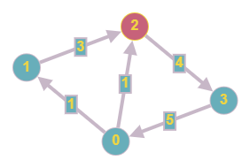
Floyd Warshall Algorithm
The problem is to find shortest distances between every pair of vertices in a given edge weighted directed Graph.
Consider this Graph.
Graph Adjacency Matrix
0 1 2 3
0 0 1 1 ∞
1 ∞ 0 3 ∞
2 ∞ ∞ 0 4
3 5 ∞ ∞ 0

Slide 10
Floyd Warshall Algorithm
The algorithm iteratively compares the current path length with the length of alternative paths between the respective nodes, and stores the minimal length.
The length of the path (i, j) is determined to be the minimal value of the current length and the sum of the lengths of (i, k) and (k, j).
d(i, j) = min{d(i, j), d(i, k) + d(k, j)}
In this step the length of the path between nodes i and j is improved.
The new path consisting of subpaths (i, k) and (k, j) is shorter than the current path (i, j).

Slide 11
Floyd Warshall Algorithm
Consider first row and first column.
include all dis[i][j] and dis[i][k],which have direct edge.
execute d(i, j) = min{d(i, j), d(i, k) + d(k, j)}
For every pair (i, j) of the source and destination vertices respectively, there are two possible cases.
k is not an intermediate vertex in shortest path from i to j. We keep the value of dist[i][j] as it is.
k is an intermediate vertex in shortest path from i to j. We update the value of dist[i][j] as dist[i][k] + dist[k][j] if dist[i][j] > dist[i][k] + dist[k][j]
Next we repeat same for each row and column.

Slide 12
Floyd Warshall Algorithm
The final matrix looks as follows:
0 1 2 3
0 0 1 1 5
1 12 0 3 7
2 9 10 0 4
3 5 6 6 0

Slide 13
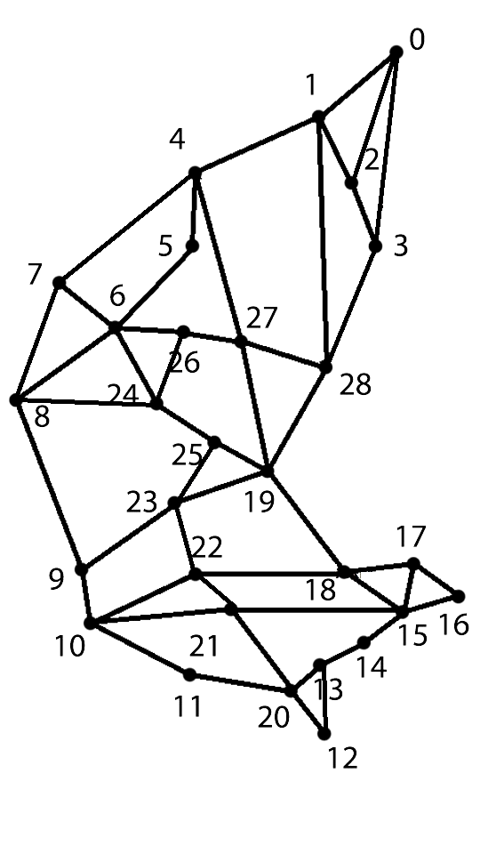
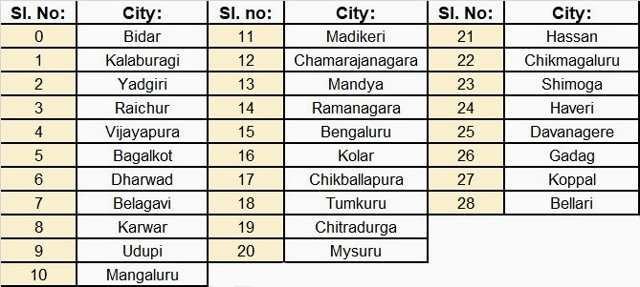
map

Slide 14
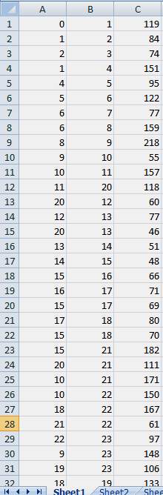
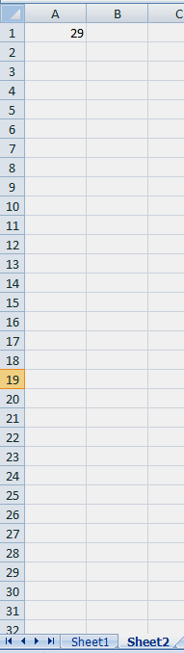
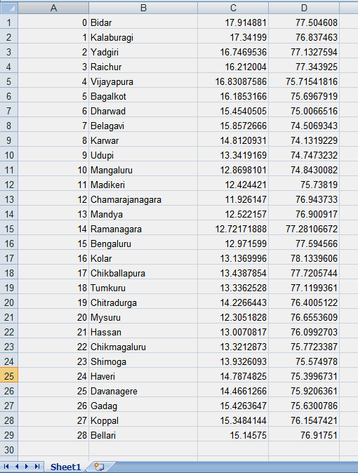

Slide 15
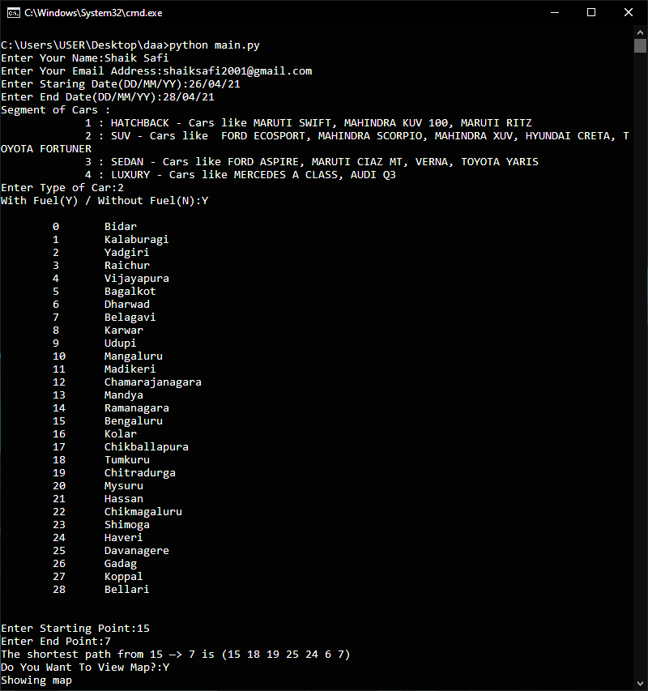


Slide 16
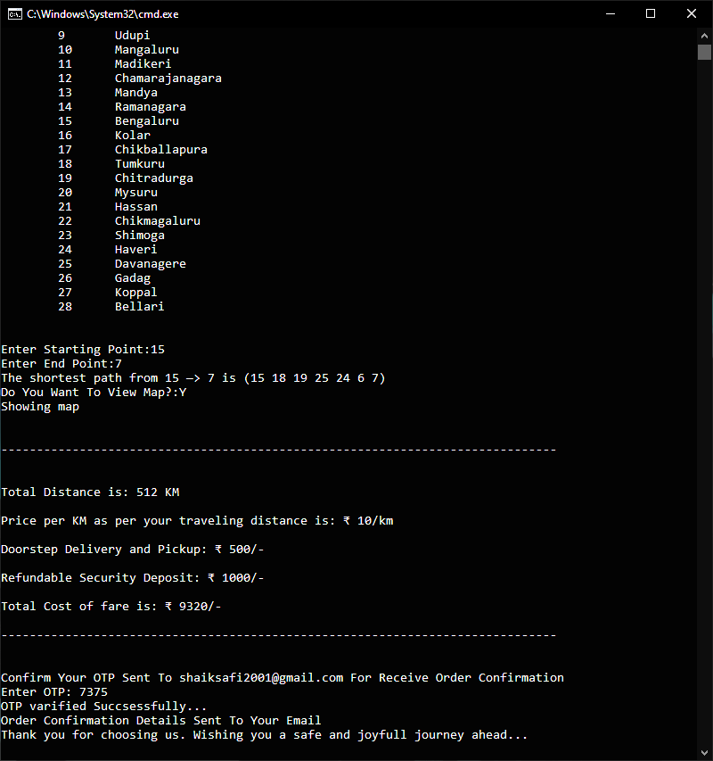

Slide 17
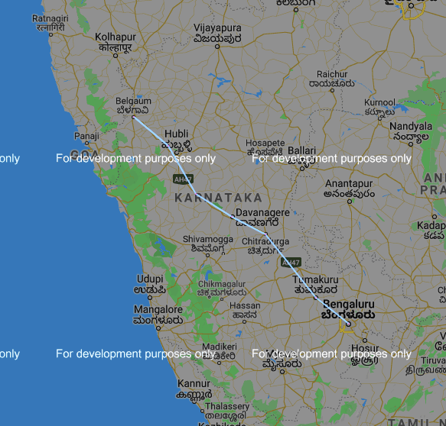
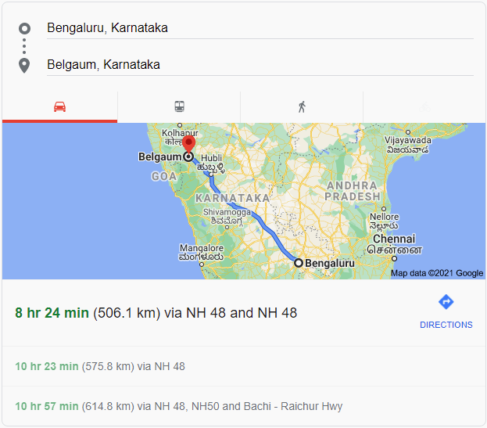

Slide 18
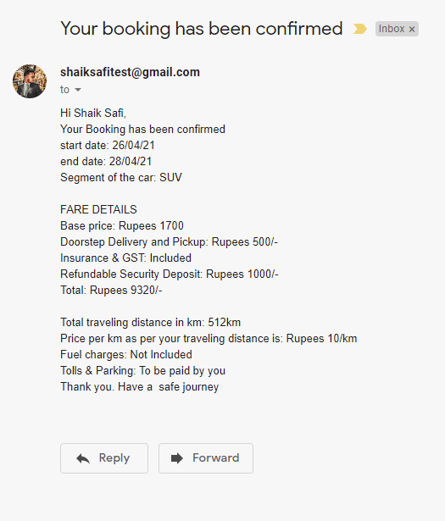


Slide 19
Programming is the art of algorithm design and the craft of debugging code.

Slide 20
Thank you!

